Slide 1

2025 Converse family reunion

Slide 2

AGENDA
Lodging
Timeline of Events
Activities
Food Logistics
Transportation
Key Role Assignments

Slide 3
Lodging: Michelle
REMINDER OF PRIORITIES, NEEDS AND WANTS
Bedroom Count/variety
Dining Space/Common Spaces
Accessibility
Rec space
Outdoor & Indoor spaces
Kid-friendly spaces
5. Distance to extra curriculars
6. Budget
NEEDS: Ensuite on ground level, game/rec room, fully stocked kitchen, handicap accessible, linens, <30mins from DT, wifi, parking, outdoor smoking areas
WANTS: kid play places, coffee bar, community area for rec, VIEWS, baby changing station, outdoor grill, pizza oven, (pool is plus but not required)
ACTION: PICK HOUSE & BOOK

Slide 4

Family count: 23
Confirm room assignments
Room1:
Russ
Erin
Room2:
Danielle
Anthony
Room3:
Brooklyn
Leylah
Kristina
Alex
Room4:
Ryder
Room5:
Nana
Papa
Room6:
Michelle
George
Room7:
Danny
Casey
Room8:
Darrin
Taryn
Room9:
Aaron
Room10:
Saryn
Zach
Dakota
Charlotte
Room11:
Abuela
Notes:
Are you planning for a small, intimate gathering (just immediate family) or a large-scale event with extended family (cousins, uncles, aunts, etc.)? Knowing this early helps with decisions on venue, accommodations, and budget. Consider whether you want to focus on a specific branch of the family or include everyone.

Slide 5
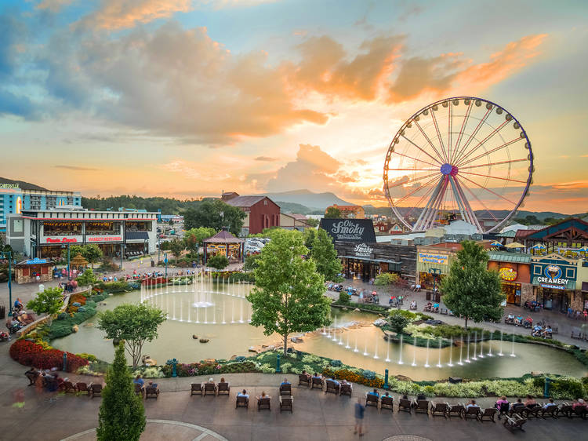
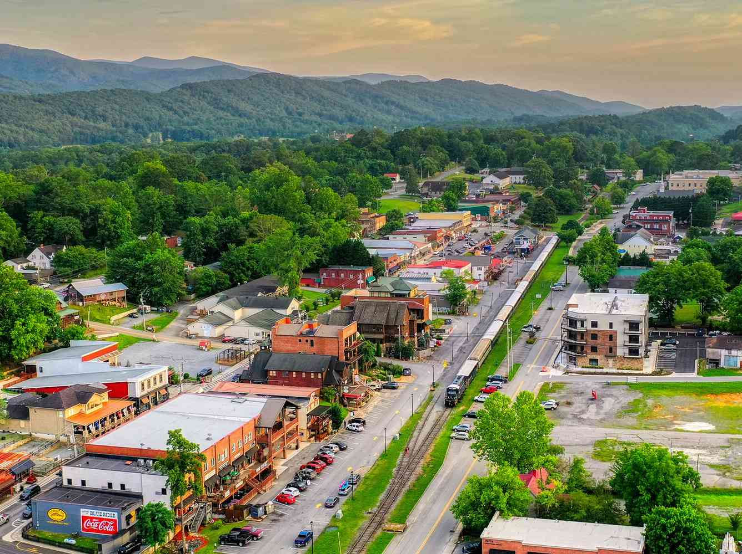
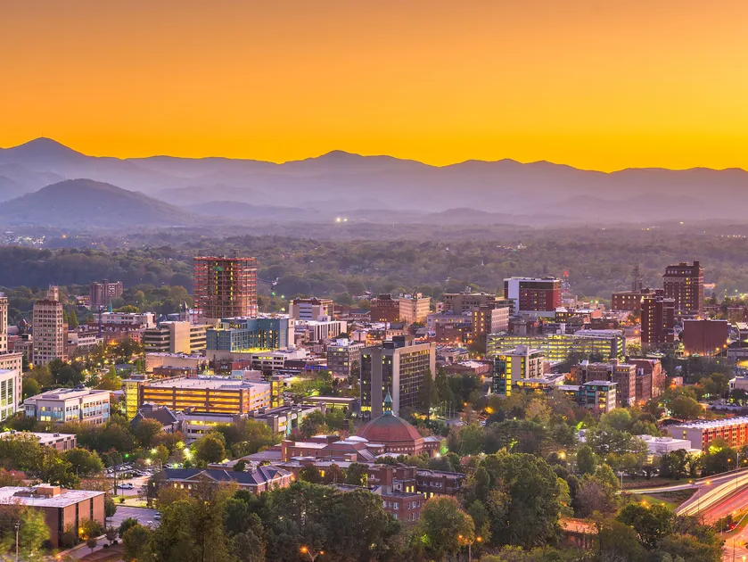
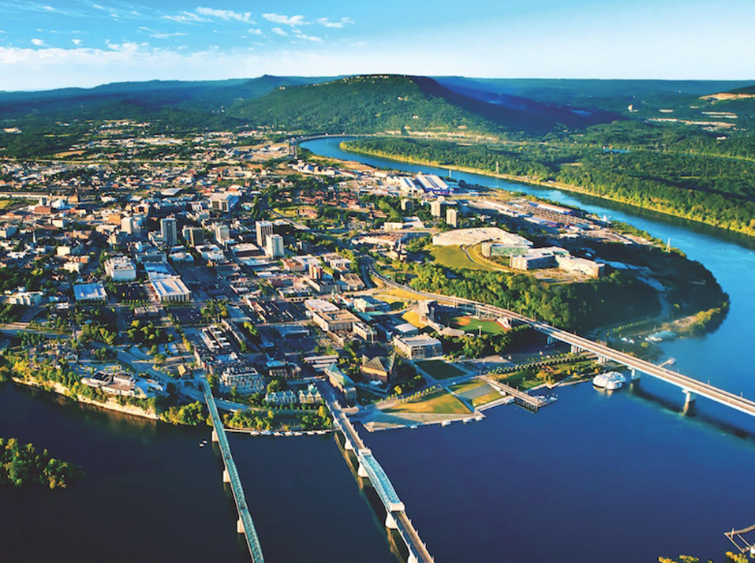
Activities: Danny
Activity 1
Activity 2
ACTIVITY 3
ACTIVITY 4

Slide 6
Example Timeline
Friday
Check-in
Thursday
Mini golf comp
Friday
Final breakfast
Saturday
Tuesday
Wednesday
Sunday
Dollywood
Hiking
Monday
Family History/ Story Telling
Spa/ Relaxation
Gatlinburg
Icebreaker
Casual Dinner
Unpack
DT Dinner
Family Movie Night
Free time
BBQ
Smores
Group Games
Dinner Show?
Game Night
Pool Day
Family Lunch
Whitewater rafting or tubing
Dinner at House
Anakeesta/ Chondola
Ripleys Aquarium
Mainstreet
Dinner in Gatlinburg?
Gokarts/ Ziplines
Dinner together
Family Award Ceremony/ Slide show?
Photographer?

Slide 7
Food

Slide 8
Transportation (Palm bay only)
Car Capacity | Driver/Passengers
Cadillac Seats: 4 Luggage: | Drivers: Papa, Danny Passengers: Nana, Casey
Ford Explorer Seats: 7 Luggage: | Drivers: Michelle, George
Danielle’s car Seats: 7 Luggage: | Drivers: Danielle, Anthony Passenger: Ryder, Leylah, Krystina, Alex
Darrin’s car Seats: Luggage: | Drivers: Darrin Passengers: Taryn, Abuela, Aaron
Saryn’s car Seats: Luggage:

Slide 9

Key Roles (Assign here)
Consider Roles:
Activity Administrator: Danny
Responsible for finding, organizing, and executing excursions and family activities
Provisions Principal: George
Responsible for determining food needs, organizing rotation, and shopping for groceries
Communications Coordinator:
Main POC for sending out updates, invites, meeting reminders, fielding questions to committee, and daily newsletter during event?
Logistics Lead: Casey
Responsible for accommodations, transportation, venue/group bookings, ensuring timeline goes would a hitch!
Money Manager: Danny/Casey
Estimates budget, tracks expenses, handles contributions, manages finances, keeps it in a nice excel spreadsheet
Save data, files, email confirmations, etc, here: one drive
If you don’t have Microsoft 365, Casey has room for 3 accounts on Microsoft family account

Slide 10
Actions!
DESCRIPTION | POC | DEADLINE | STATUS
Book Lodging |  | 10/14
Assign Rooms
Something with activities
Estimate food
Generate Save the Date
Research Photographers | Casey
Research Restaurants | Casey

Slide 11

Final Thoughts?
Next Meetings Topics – Determine next meeting!
Review timeline
Query interest in activities
Make reservations for events
Estimate food needs and contributions
Send Save the dates
By Next Meeting, We should know:
Available activites
Notes:
2025 Converse Family Reunion

Slide 12

Thank you
See you next meeting!

